Slide 1


Building a Python Currency Converter
Learn to create a practical currency converter using Python, exploring fundamental programming concepts and external data.
by Gangadhar

Slide 2
Agenda: Your Learning Journey
1
Project Overview
2
Core Concepts
3
External Data
Understand the goal and key features.
Explore essential Python elements.
Integrate real-time exchange rates.
4
Building the App
5
Enhancements
Step-by-step development process.
Future improvements and ideas.

Slide 3
What is a Currency Converter?
Definition
Key Features
Tool to convert one currency to another.
Input amount and currencies.
Based on current exchange rates.
Fetch live exchange rates.
Essential for global transactions.
Display converted value.
User-friendly interface (optional).

Slide 4

Python Fundamentals for Our Project
Variables & Data Types
Functions
Store amounts, currencies, and rates.
Encapsulate conversion logic.
Conditional Statements
Input/Output
Handle invalid inputs or errors.
Interact with the user.

Slide 5





Accessing Real-Time Exchange Rates
APIs
Requests Library
JSON Parsing
External services for data.
Fetch data from web APIs.
Extract relevant rate information.
Data Handling
Store and use fetched rates.

Slide 6
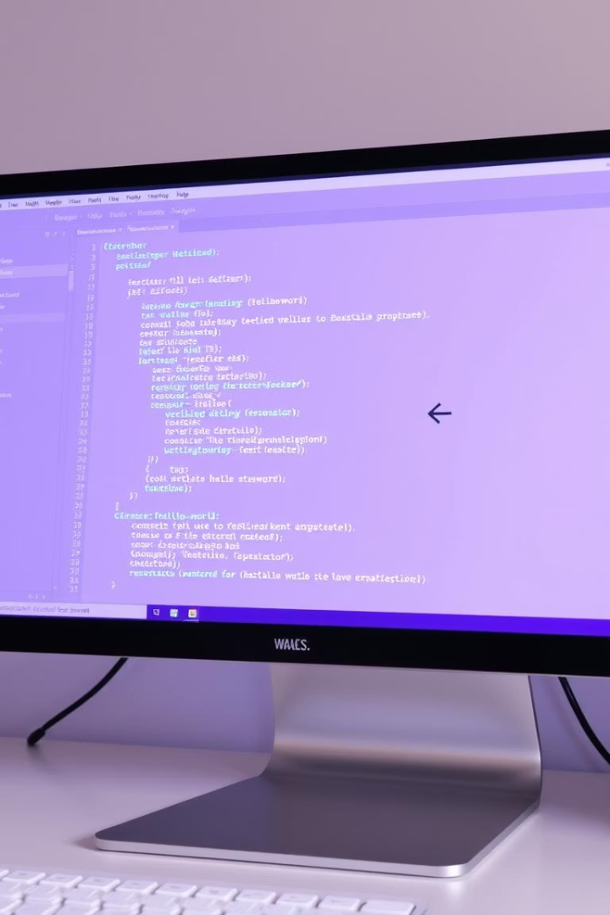




Step-by-Step Development
User Input
Prompt for amount, source, target currency.
Fetch Rates
Call API to get current exchange rates.
Perform Calculation
Apply formula: Amount * (Target/Source Rate).
Display Result
Show the converted amount to the user.

Slide 7

Handling Errors and Edge Cases
1
Invalid Currency
Check if currency codes are valid.
2
API Failure
Implement retry mechanisms or error messages.
3
Zero Input
Prevent division by zero or nonsensical results.
4
Network Issues
Handle connection errors gracefully.

Slide 8






Enhancing Our Converter
Historical Rates
View past exchange rate trends.
Graphical Interface (GUI)
Create a visual, interactive application.
Rate Alerts
Notify users when rates change.

Slide 9








Beyond the Basics: Advanced Features
Automated Updates
Currency Portfolio
Schedule rate fetches automatically.
Track value of multiple currencies.
Configuration Options
Command-Line Interface
Allow users to customize settings.
Build a robust console application.

Slide 10

Key Takeaways & Next Steps
Practice Makes Perfect
Experiment with code, build more projects.
Explore Libraries
Leverage Python's rich ecosystem (Requests, Tkinter).
Continuous Learning
Stay updated with best practices and new tools.

